Slide 1
Module 14: Implement an Application Infrastructure
Azure App Service, Networking for an App Service, and Deployment Slots

Slide 2

Learning Objectives (1 of 3)
You will learn the following:
Create and Configure Azure App Service
Create an App Service Web App for Containers
Create and Configure an App Service Plan
Configure Networking for an App Service
Create and Manage Deployment Slots
Implement Logic Apps
Implement Azure Functions

Slide 3
Create and Configure Azure App Service

Slide 4
Azure App Service Overview (1 of 3)
Azure App Service is an HTTP-based service for
hosting web applications
REST APIs
mobile back ends
You can develop in.NET, .NET Core, Java, Ruby, Node.js, PHP, or Python
Applications run and scale on both Windows and Linux-based environments.

Slide 5
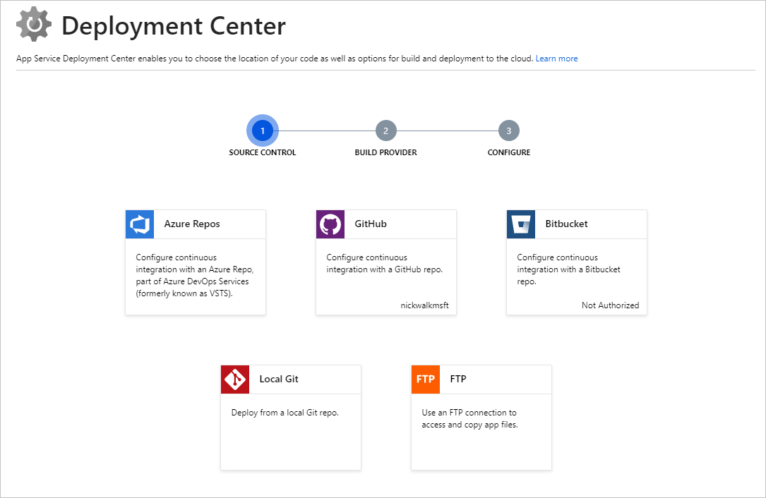
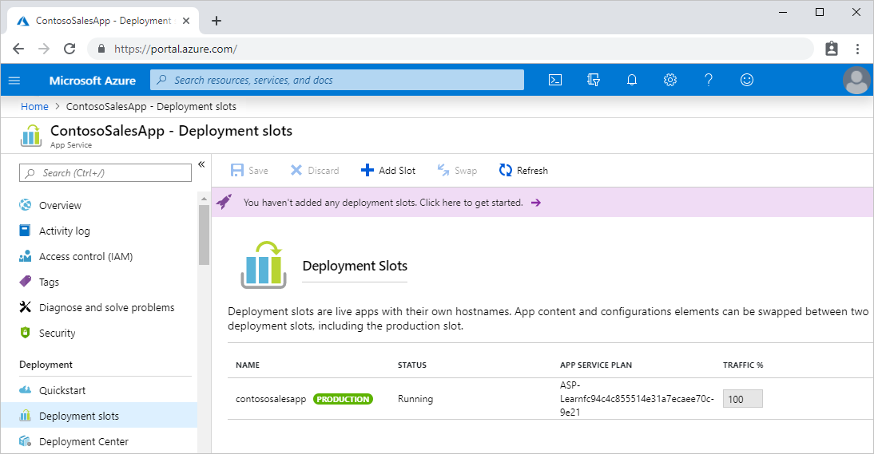
Azure App Service Overview (2 of 3)
Azure App Service facilitates Continuous Integration/Continuous Deployment
Integrates with Azure DevOps, GitHub, Bitbucket, FTP, or a local Git
Supports deployment slots

Slide 6
Azure App Service Overview (3 of 3)
Creating a web app
Subscription
Resource group
App name
Publish
Runtime stack
Operating system
Region
App service plan
An App Service plan
set of virtual server resources that run App Service apps
determines the performance characteristics
determines App Service features that apps have access to

Slide 7
Demonstration: Azure App Service
Use the Azure Portal to create an Azure App Service plan and a web app

Slide 8
Create an App Service Web App for Containers

Slide 9
Azure Container Registry
Container Registry allows you to
create a private image registry
automate tasks such as redeploying an app when an image is rebuilt
To create a Container Registry, run
az acr create --name myregistry --resource-group mygroup --sku standard --admin-enabled true
To build images and store them in a Container Registry, run
az acr build --file Dockerfile --registry myregistry --image myimage .

Slide 10
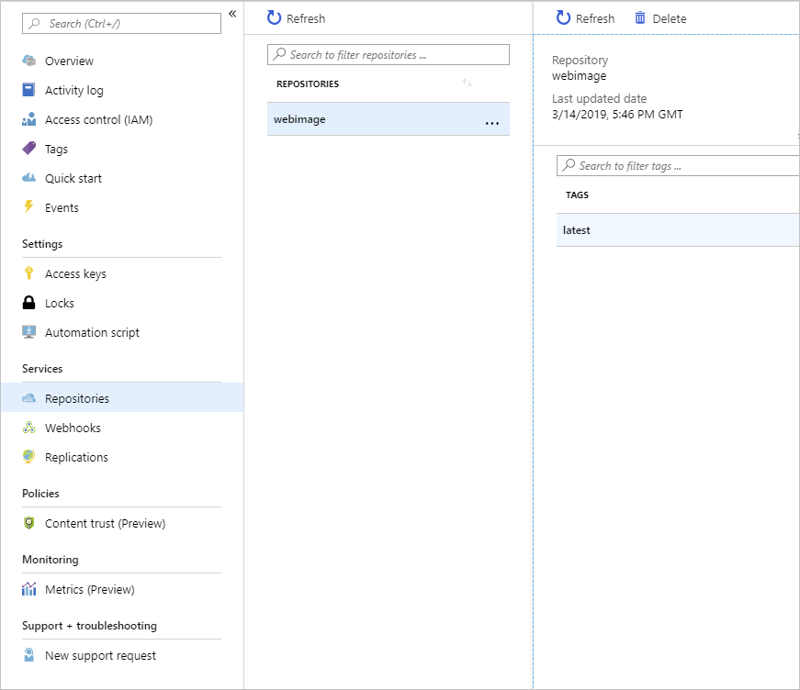
Build an Image using Azure Container Registry
Create a registry in Azure Container Registry
Build a Docker image and upload it to Azure Container Registry
Examine the container registry

Slide 11
Deploy a Web App from a Docker Image
Create a new web app by using the Docker image stored in Azure Container Registry
Test the web app
Property | Value
Subscription | The target Azure subscription in which you are allowed to create and manage resources.
Resource Group | A resource group name
Name | A globally unique name of the web app you are deploying
Publish | Docker Image
OS | Linux
App Service plan | Use the default

Slide 12
Create and Configure an App Service Plan

Slide 13
Azure App Service Plans
An App Service plan defines a set of compute resources for web apps
These compute resources are analogous to the server farm in the traditional web hosting
App Service plan determines capabilities and resources available to its web apps
Web apps can share the same App Service plan
Isolate your app into a new App Service plan when
The app is resource-intensive
You want to scale the app independently from other apps
The app needs resources in a different geographical region

Slide 14
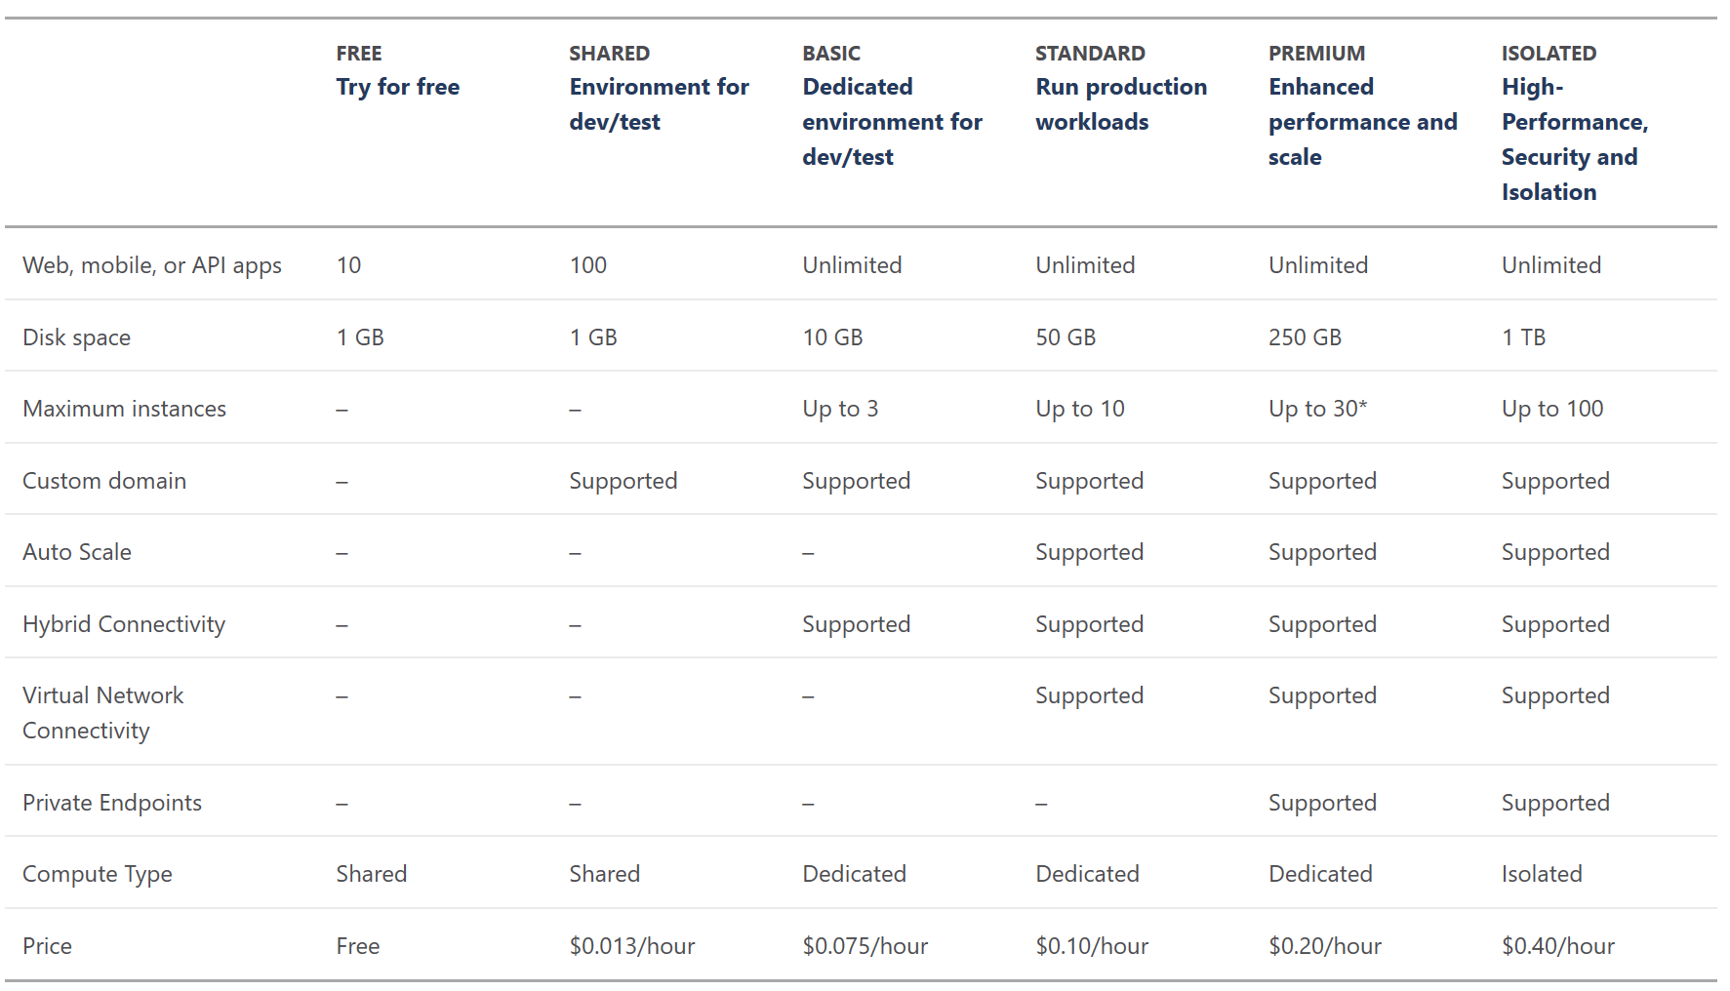
App Service Plan Pricing Tiers

Slide 15
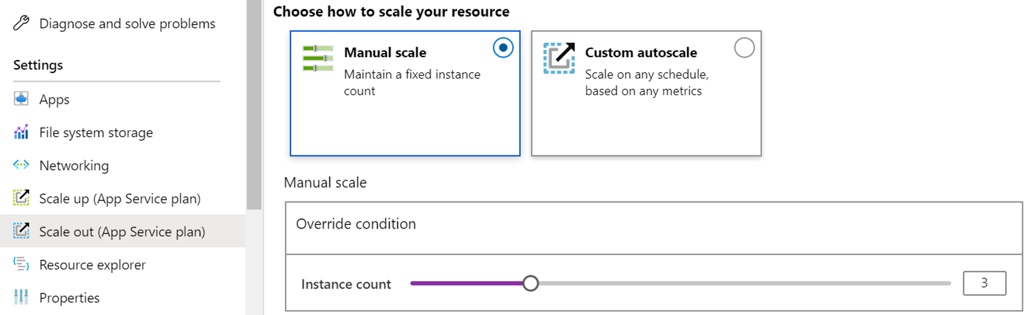
App Service Plan Scaling (1 of 2)
There are two workflows for Web App scaling:
Scale up
Scale out

Slide 16
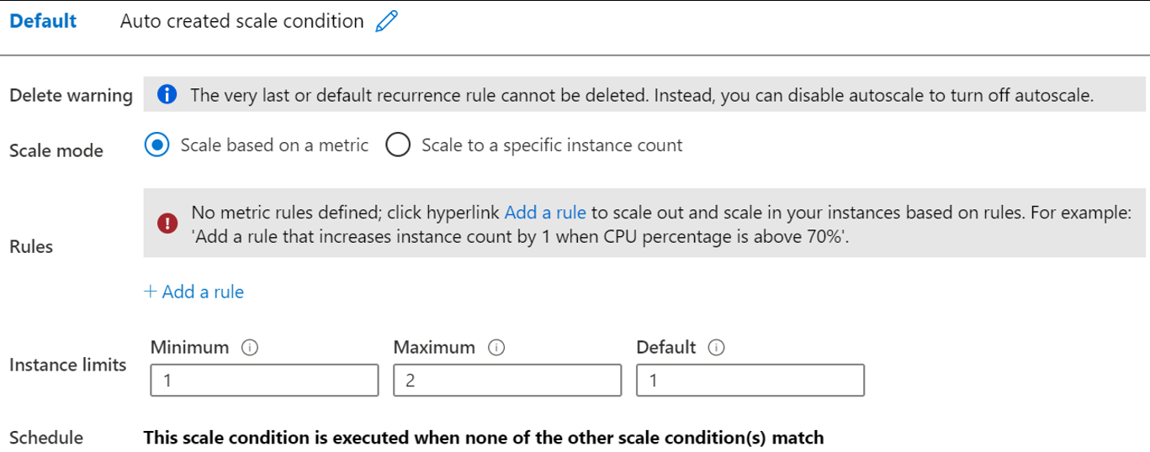
App Service Plan Scaling (2 of 2)
Changing your app service plan (scale up)
Other considerations:
The scale settings take only seconds to apply and affect all apps in your App Service plan
If your app depends on other services, you can scale up these resources separately

Slide 17
Demonstration: Create an App Service Plan
Create an App Service plan
Review pricing tiers

Slide 18
Configure Networking for an App Service

Slide 19
Integrate an App with an Azure Virtual Network
Azure App Service has two variations on Net Integration:
Multitenant systems that support the full range of pricing plans except Isolated.
App Service Environment, which deploys into your VNet and supports Isolated pricing plan apps.
The VNet Integration feature has two variations:
Regional VNet Integration: When you connect to Azure Resource Manager virtual networks in the same region, you must have a dedicated subnet in the VNet you're integrating with.
Gateway-required VNet Integration: When you connect to VNet in other regions or to a classic virtual network in the same region, you need an Azure Virtual Network gateway provisioned in the target VNet.

Slide 20
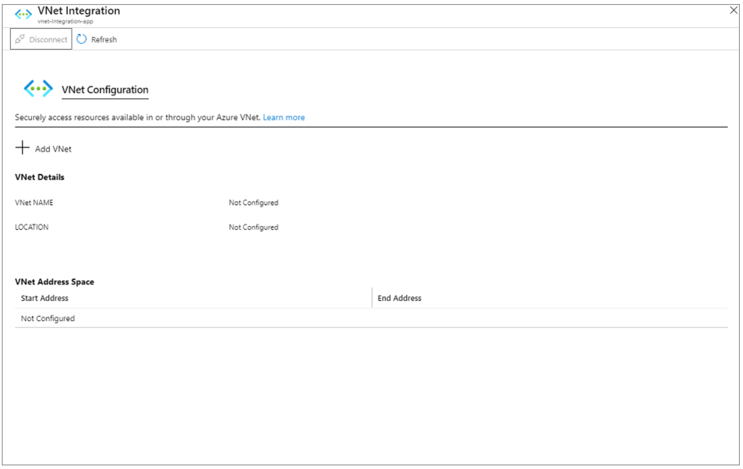
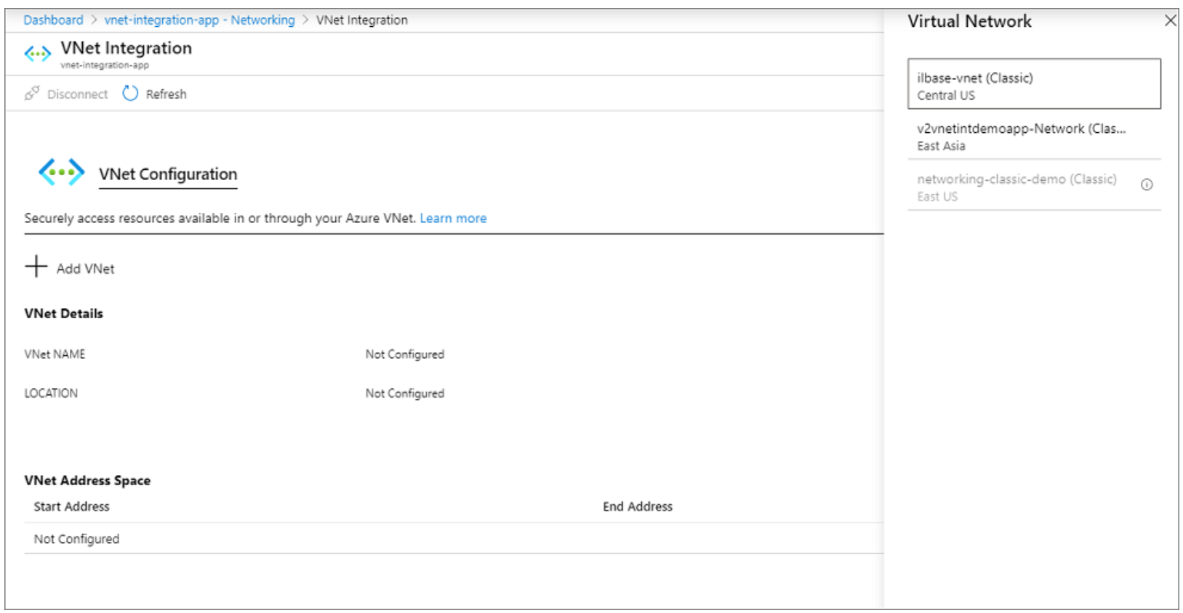
Enable VNet Integration
Go to the Networking UI in the App Service portal.
Under VNet Integration, select Click here to configure.
Select Add VNet.

Slide 21
Regional VNet Integration
Using regional VNet Integration enables your app to access:
Resources in a VNet in the same region as your app.
Resources in VNets peered to the VNet your app is integrated with.
Service endpoint secured services.
Resources across Azure ExpressRoute connections.
Resources in the VNet you're integrated with.
Resources across peered connections, which includes Azure ExpressRoute connections.
Private endpoints.

Slide 22

Create and Manage Deployment Slots

Slide 23
Deployment Slots
You can create multiple deployment slots within a single Azure App Service web app
Each slot is a separate instance of that web app, and it has a separate host name
You can deploy a different version of your web app into each slot
Each slot
Has its own URL
shares the resources of the same App Service plan

Slide 24
Slots and Tiers
The number of available deployment slots depends on the pricing tier of the App Service plan
Avoid a cold start during swaps
Tier | Maximum staging slots
Free | 0
Shared | 0
Basic | 0
Standard | 5
Premium | 20
Isolated | 20

Slide 25
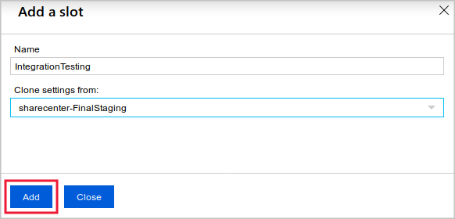
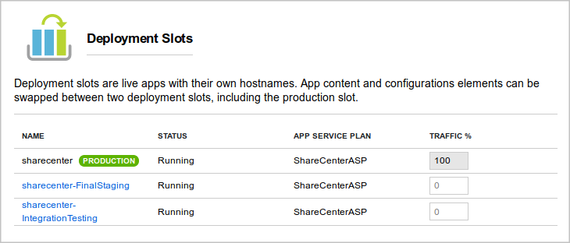
Create a Deployment Slot

Slide 26
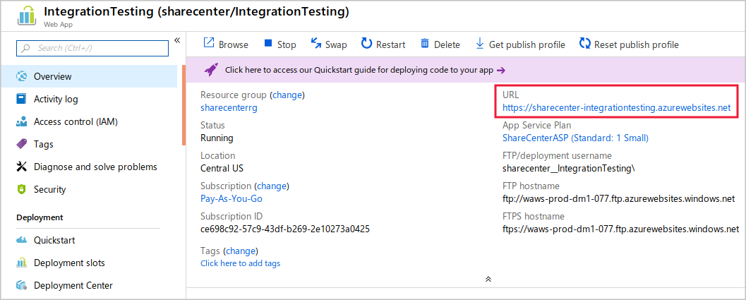
Access a Deployment Slot

Slide 27

Implement Azure Functions

Slide 28

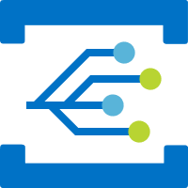






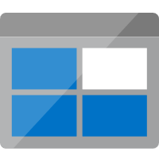
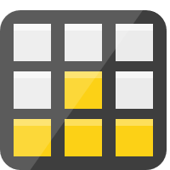


Azure Functions (1 of 2)
Run code based on HTTP requests
Schedule code to run at predefined times
Process new and modified:
Azure Cosmos DB documents
Azure Storage blobs
Azure Queue storage messages
Respond to Azure Event Grid events by using subscriptions and filters
Respond to high volumes of Azure Event Hubs events
Respond to Azure Service Bus queue and topic messages
Notification Hubs
Event Grid
Event Hubs
Cosmos DB
Twilio
Azure
Functions
Storage
Service Bus
Queue
Blob
Table
Topics
Queues
Notes:
Lambda, Azure Functions, Azure Web-Jobs, and Azure Logic Apps
Azure Functions is the primary equivalent of AWS Lambda in providing serverless, on-demand code. However, Lambda functionality also overlaps with other Azure services:
WebJobs allow you to create scheduled or continuously running background tasks.
Logic Apps provides communications, integration, and business rule management services.
What can I do with Functions?
Azure Functions, much like AWS Lambda, is a solution for processing data, integrating systems, working with IoT, and building simple APIs and microservices. Consider Functions for tasks like image or order processing, file maintenance, or for any tasks that you want to run on a schedule.
Azure Functions provides templates to get you started with key scenarios.
Azure Functions supports triggers to start execution of your code, and bindings to simplify coding for input and output data. [slides on triggers and scaling follow in Lab 1 Exercise 1 section]
Azure Functions integrate with various Azure and 3rd-party services. These services can trigger your function and start execution, or they can serve as input and output for your code. The following service integrations are supported by Azure Functions:
Azure Cosmos DB
Azure Event Hubs
Azure Event Grid
Azure Notification Hubs
Azure Service Bus (queues and topics)
Azure Storage (blob, queues, and tables)
On-premises (using Service Bus)
Twilio (SMS messages)

Slide 29

Azure Functions (2 of 2)
Azure Function templates
HTTP
Timer
Azure Cosmos DB
Blob storage
Queue storage
Event grid
Event hub
Service bus queue
Service Bus topic

Slide 30
Demonstration: Create a Function app
Create a function app
Verify your Azure function app

Slide 31
Implement Logic Apps

Slide 32
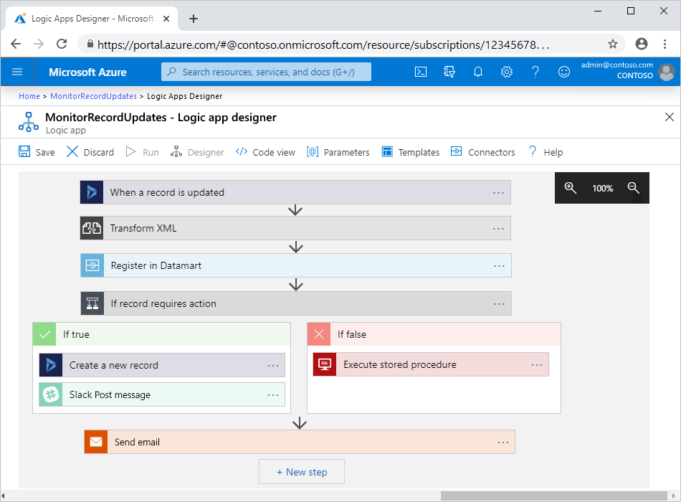
Azure Logic Apps
A cloud service used to schedule, automate, and orchestrate tasks, business processes, and workflows.
It’s used to integrate apps, data, systems, and services across enterprises or organizations.
Simplifies how you design and build scalable solutions:
Workflow starts with a trigger, which fires when an event happens, or new data meets specific criteria.
When trigger fires, Logic Apps engine creates a logic app instance that runs the actions in the workflow.

Slide 33
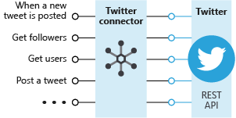
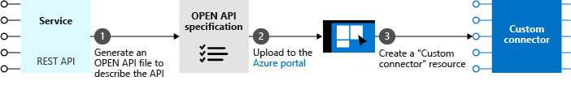
Logic Apps (1 of 2)
Connector
Custom Connectors

Slide 34
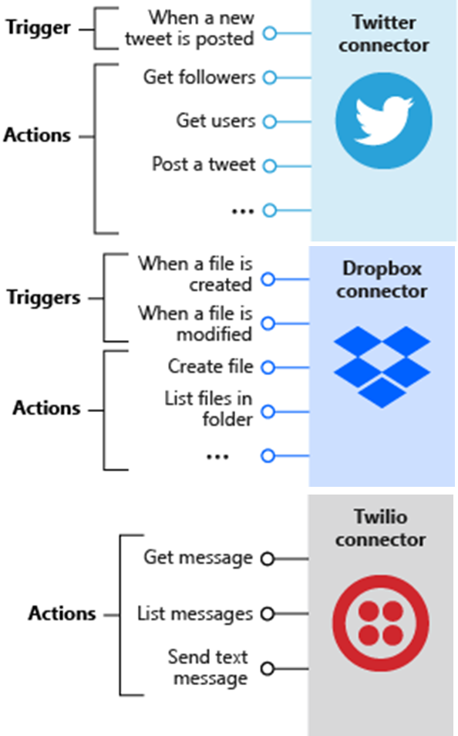
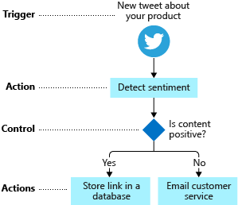
Logic Apps (2 of 2)
Triggers and Actions

Slide 35
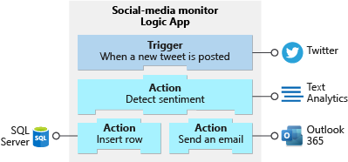
Build Logic Apps from Triggers and Actions (1 of 3)
Triggers and actions used in the social-media monitor app

Slide 36
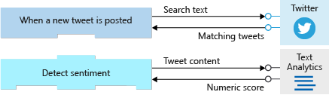
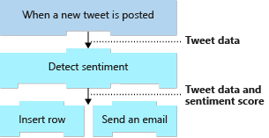
Build Logic Apps from Triggers and Actions (2 of 3)
Triggers and actions working together

Slide 37
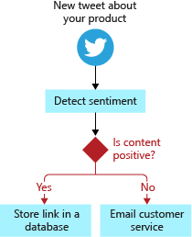
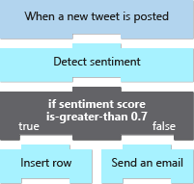
Build Logic Apps from Triggers and Actions (3 of 3)
Control actions

Slide 38
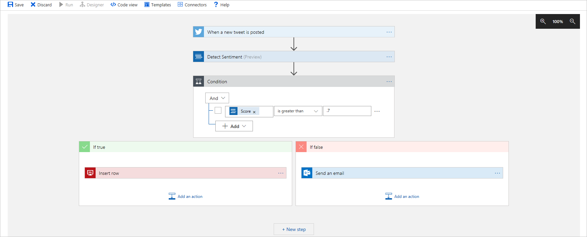
Logic Apps Designer
Logic apps designer is a graphical tool for creating workflows

Slide 39
Demonstration: Create a workflow using Azure Logic Apps
Create a logic app
Add the RSS trigger
Run the logic app

Slide 40
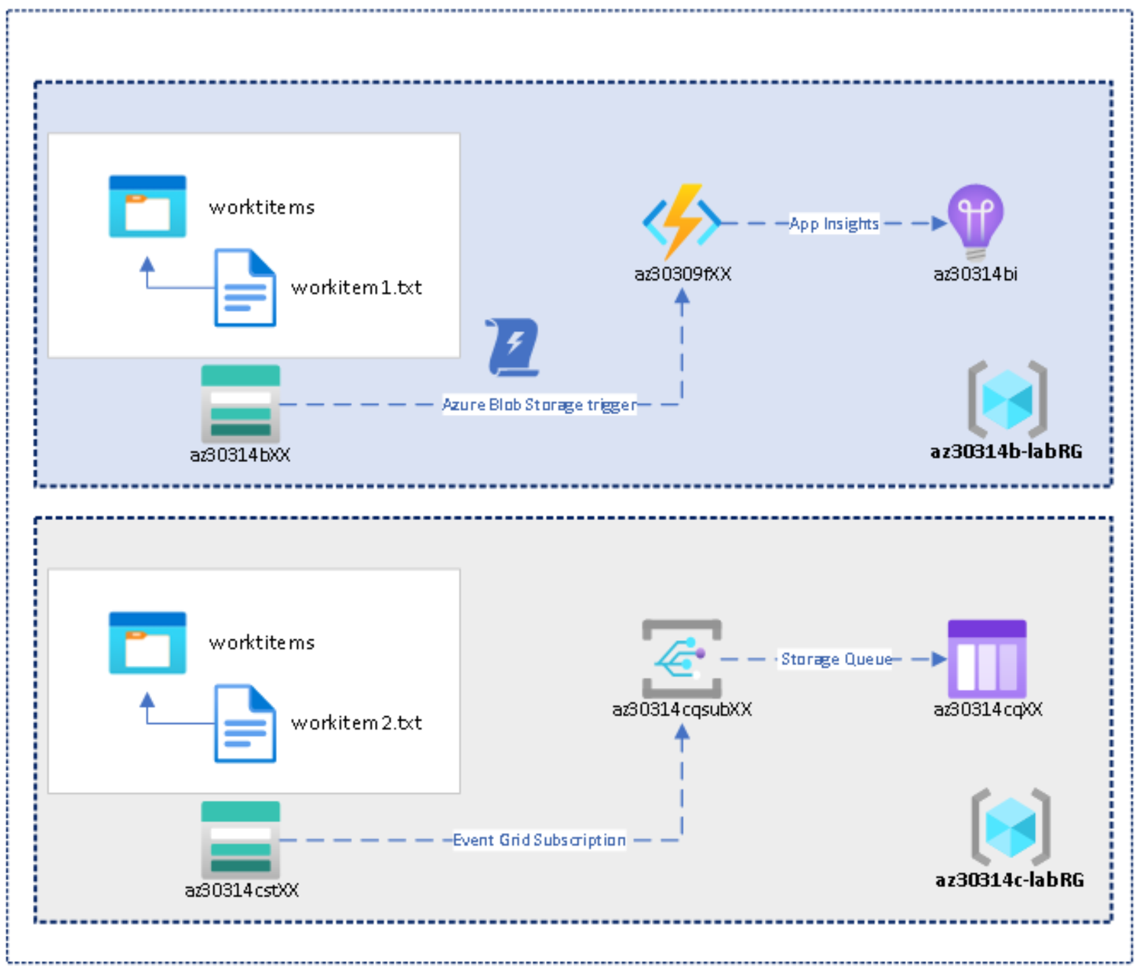
Lab: Implementing an Azure App Service Web App with a staging slot

Slide 41
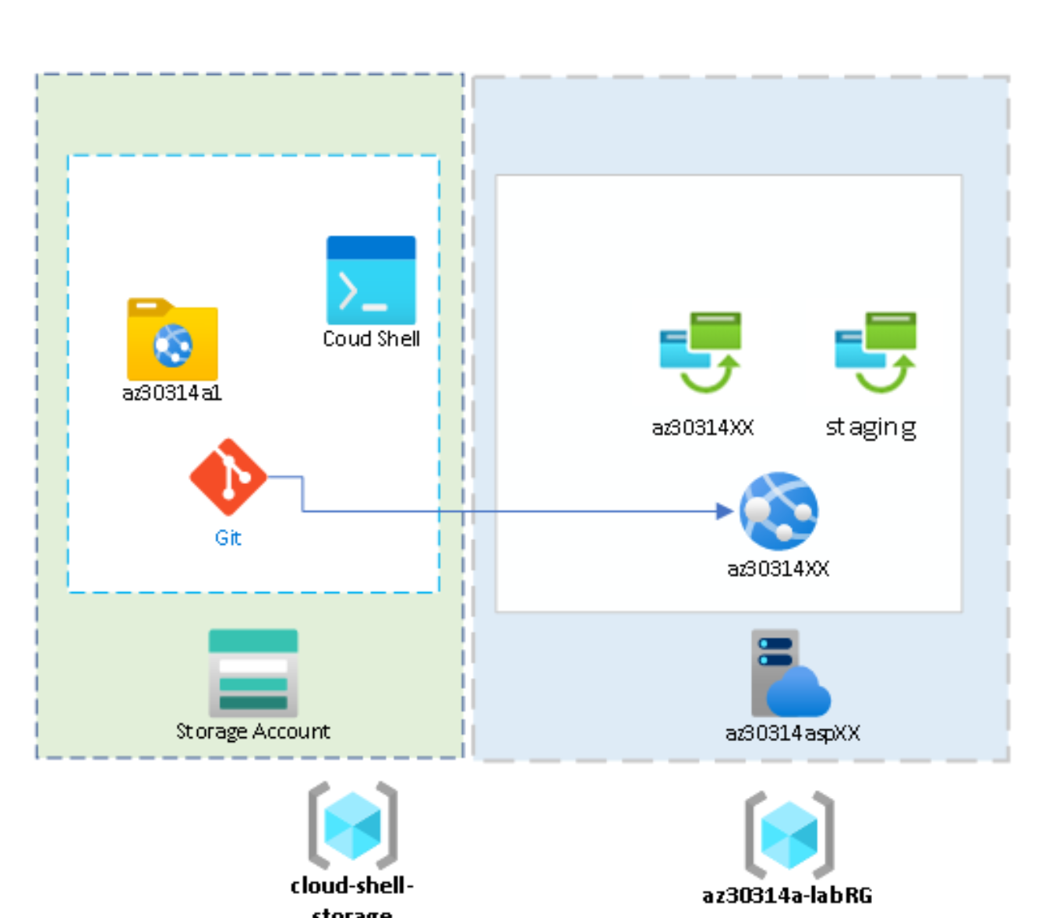
Lab: Configure a message-based integration architecture

Slide 42
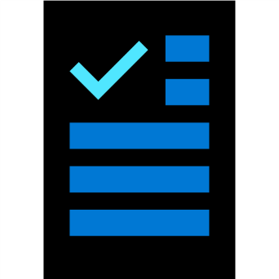
Module 14 Review Questions

